Slide 1
Personal Expense Tracker Using Java Script

Slide 2
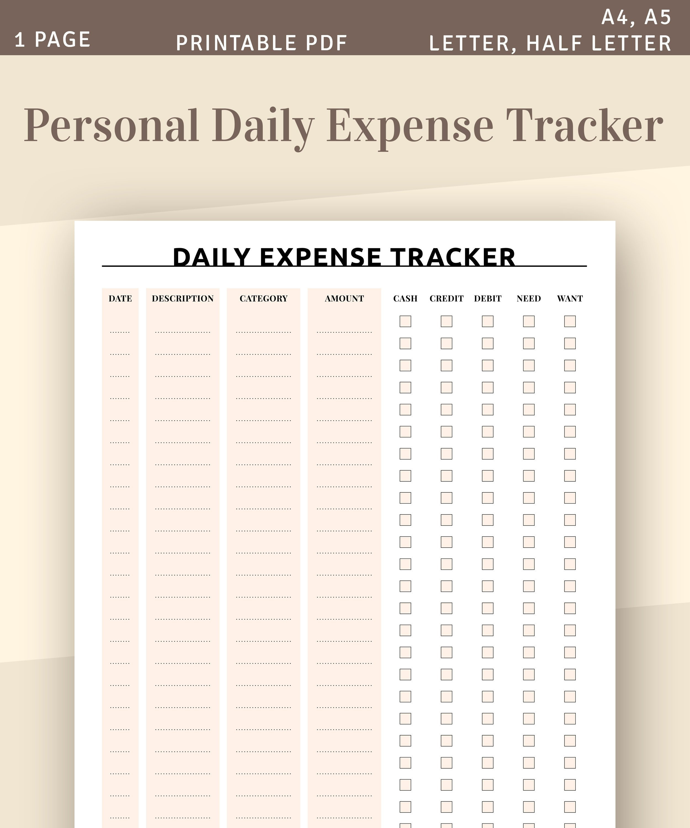
Introduction to Personal Expense Tracker
A personal expense tracker helps individuals monitor their spending habits.
It allows users to categorize expenses and visualize their financial health.
Using JavaScript, we can create an interactive and user-friendly expense tracking application.
Notes:
Image source: https://i.etsystatic.com

Slide 3
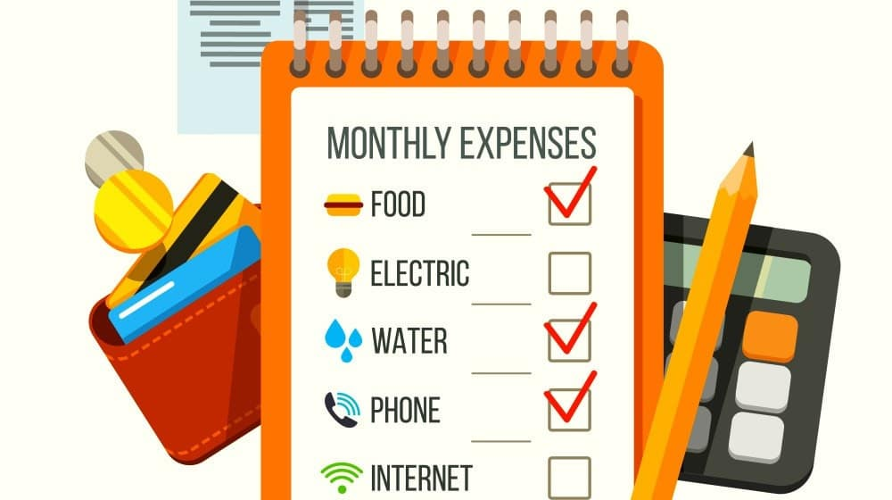
Importance of Tracking Expenses
Tracking expenses helps in budgeting and managing finances effectively.
It can identify unnecessary spending and promote saving habits.
A clear record of expenses can aid in financial planning for future goals.
Notes:
Image source: https://bookkeepers.com

Slide 4
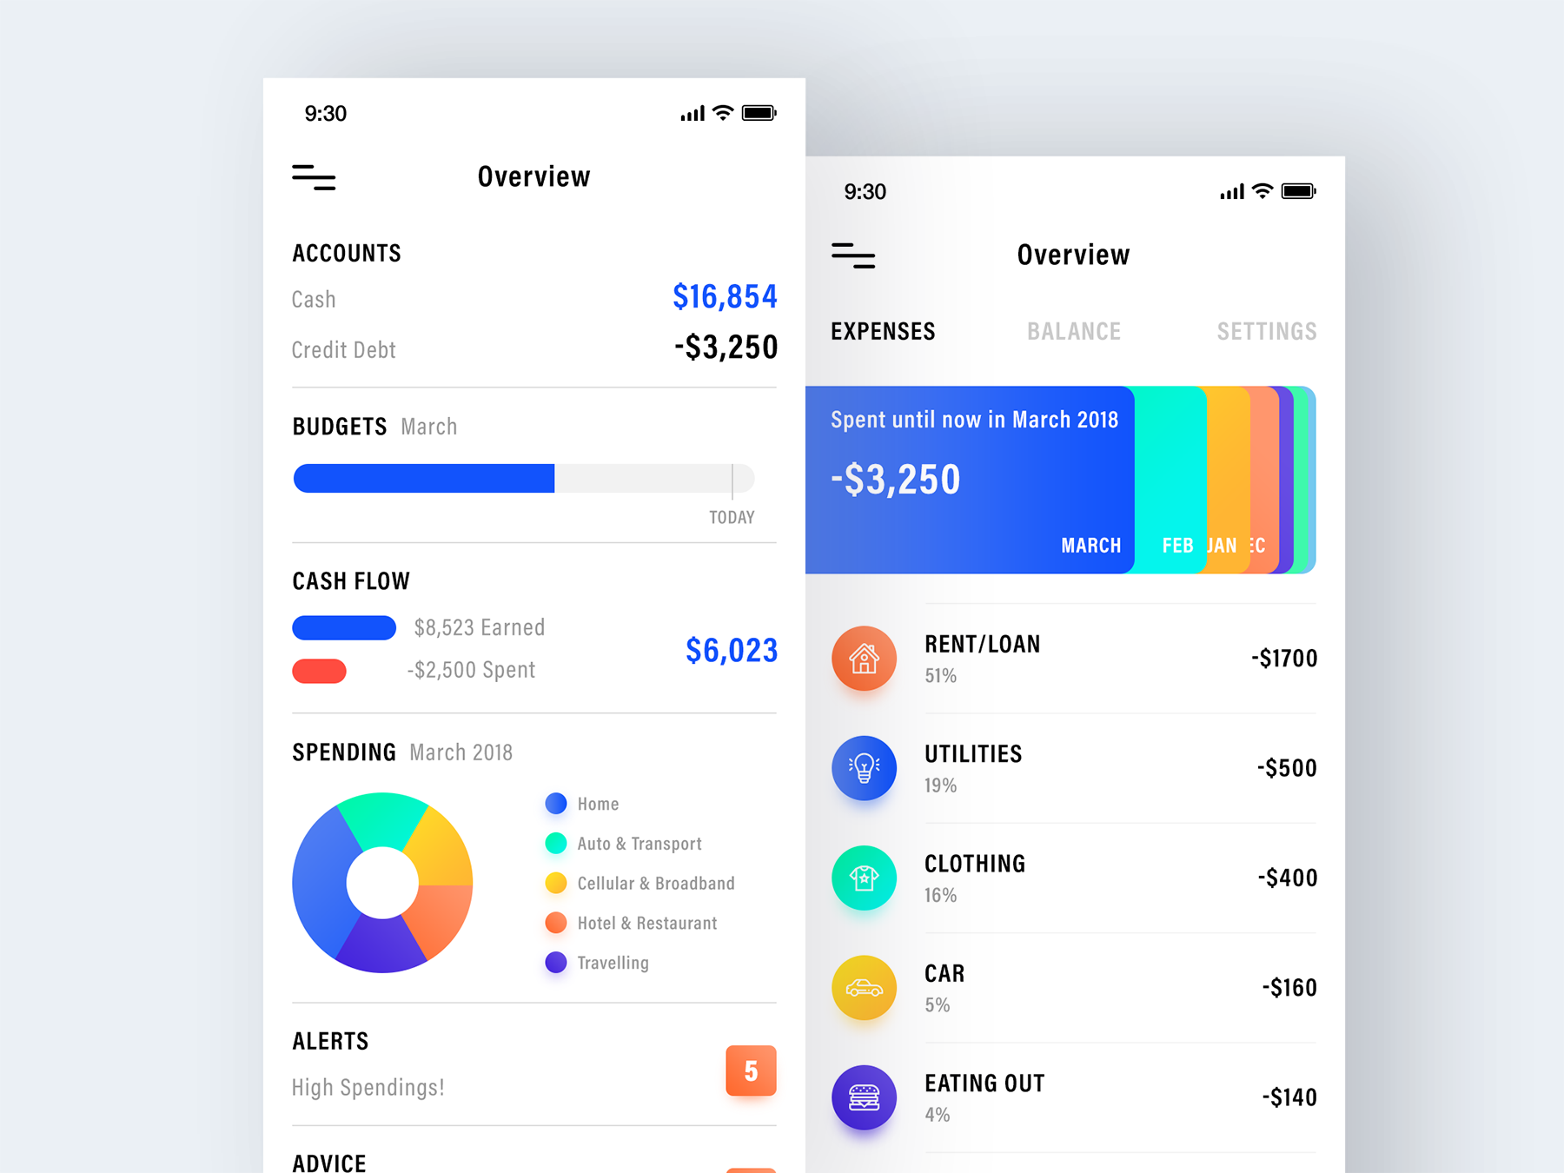
Core Features of an Expense Tracker
Users can input and categorize their daily expenses easily.
The application can generate reports and charts to visualize spending trends.
Users can set monthly budgets and receive alerts when they approach their limits.
Notes:
Image source: https://i.pinimg.com

Slide 5
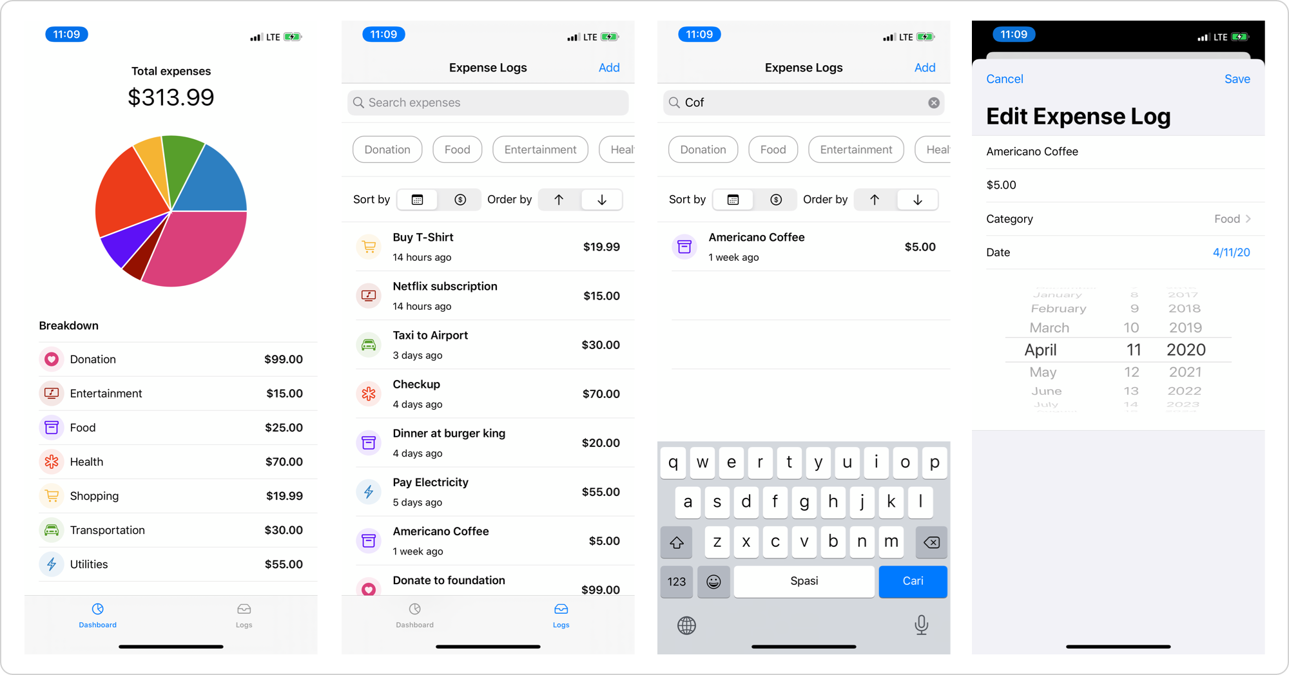
Setting Up the Environment
To start building an expense tracker, you'll need a basic understanding of HTML, CSS, and JavaScript.
A text editor or an integrated development environment (IDE) is essential for writing code.
A web browser is required to run and test your application in real-time.
Notes:
Image source: https://imagizer.imageshack.com

Slide 6
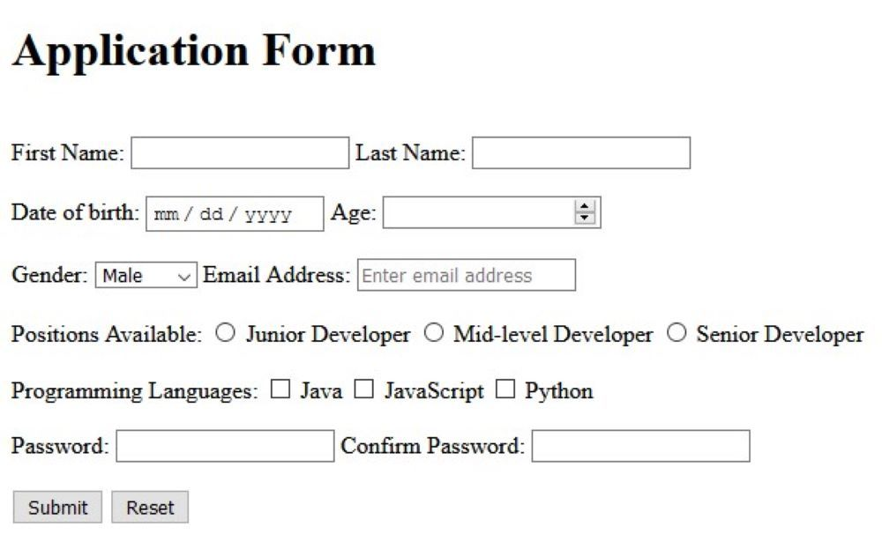
Basic Structure of the Application
The application will have a user interface to input expenses and view reports.
Use HTML to create forms for data entry and display sections for reports.
JavaScript will handle the logic for adding, editing, and deleting expenses.
Notes:
Image source: https://static1.makeuseofimages.com

Slide 7
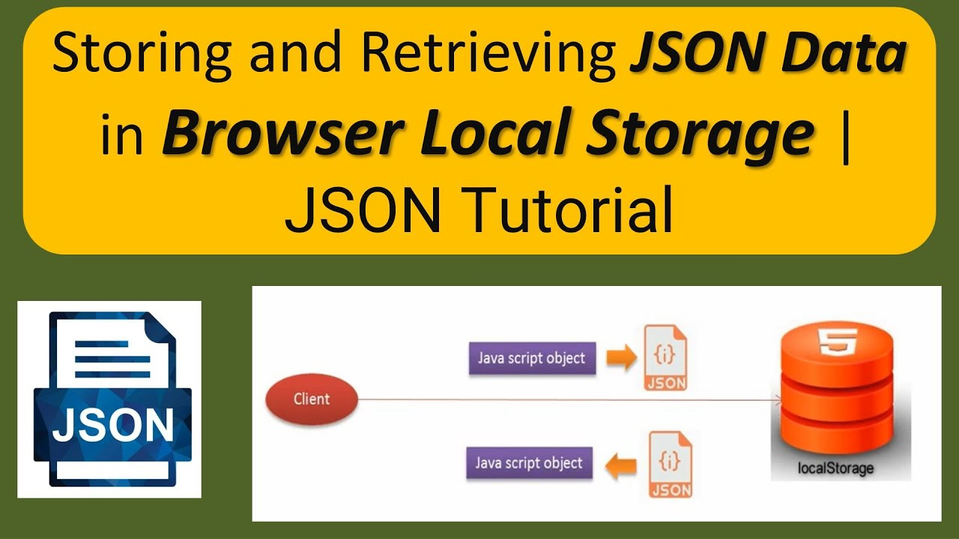
Storing Expense Data
Local storage can be used to save user data on the client side.
JSON format is ideal for storing structured data like expenses.
Ensure that the data persists even after the browser is closed or refreshed.
Notes:
Image source: https://i.ytimg.com

Slide 8
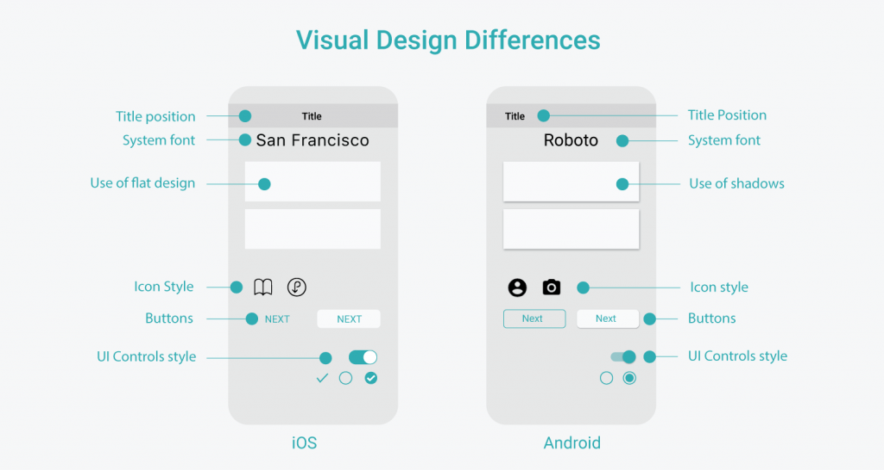
User Interface Design
A simple and intuitive design enhances user experience and engagement.
Use CSS to style the application and make it visually appealing.
Responsive design is crucial to ensure usability across different devices.
Notes:
Image source: https://www.appsdevpro.com

Slide 9
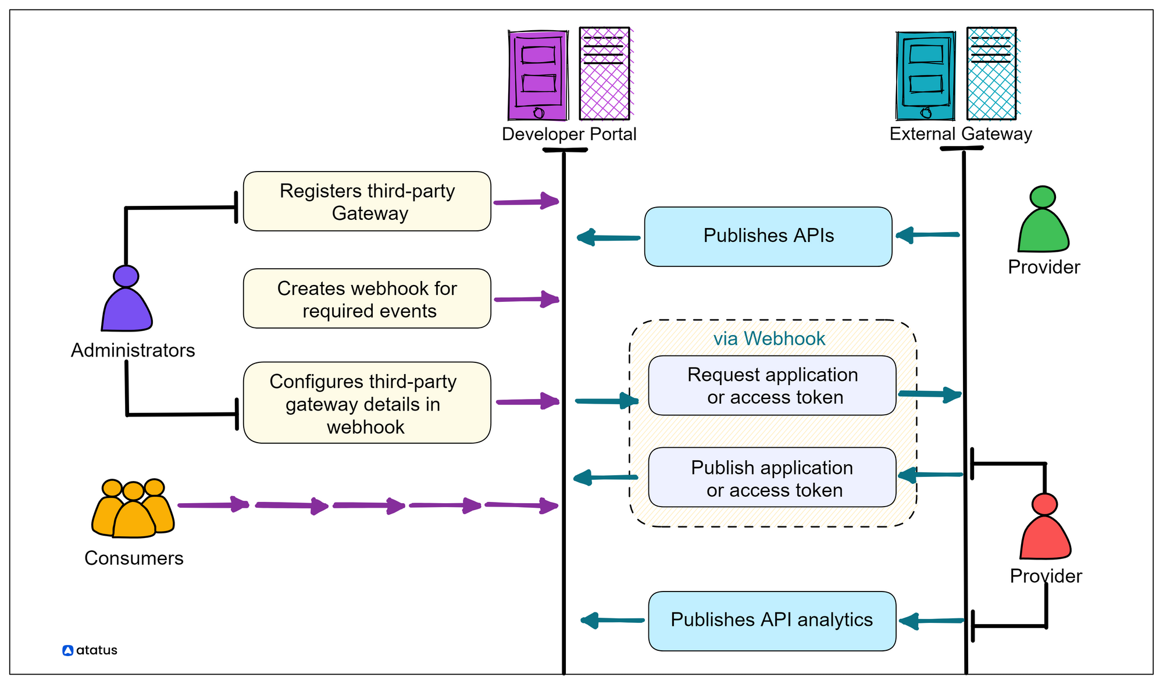
Future Enhancements
Consider integrating third-party APIs for currency conversion or financial tips.
Implement user authentication to allow multiple users to manage their expenses securely.
Explore the use of data visualization libraries to enhance reporting features.
Notes:
Image source: https://www.atatus.com

Slide 10
Summary and Conclusion
A personal expense tracker built with JavaScript can significantly improve financial awareness.
Continuous improvements and user feedback can refine the application further.
Building such an application is a great way to practice JavaScript and develop useful skills.
Notes:
Image source: https://i.pinimg.com

Slide 11
References
Mozilla Developer Network (MDN) Web Docs.
W3Schools Online Web Tutorials.
JavaScript.info

